Slide 1
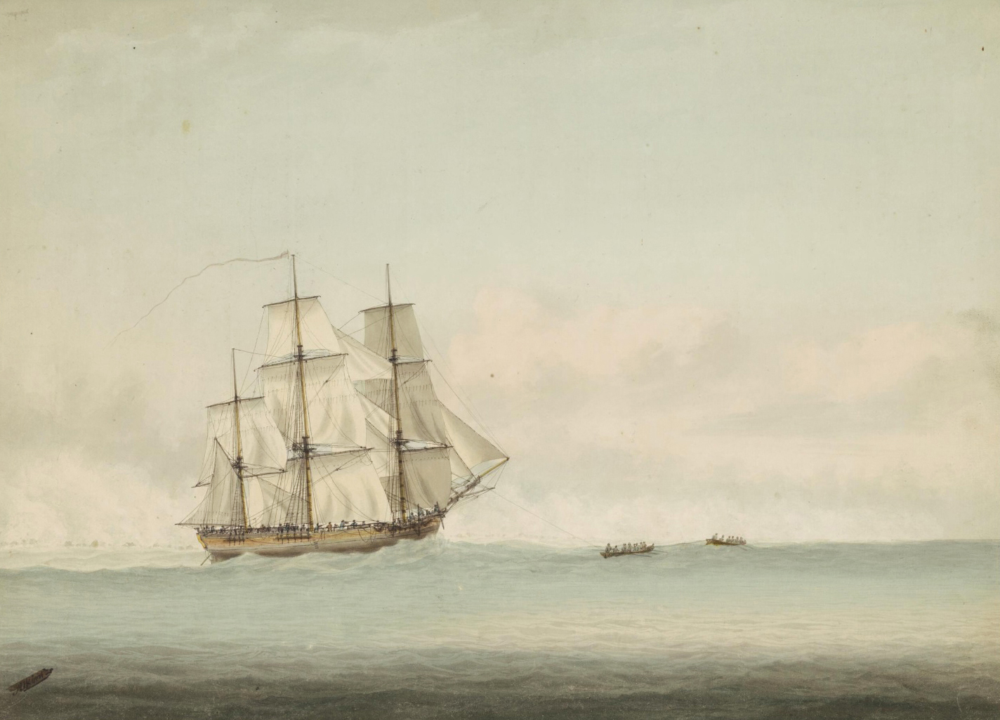
Vocabulary
Imagine you are Captain Cook.
What would it feel like on board the Endeavour?
What can you see?
What can you hear?
What can you smell?
What can you taste?

Slide 2
You have just set sail. The crew are feeling excited to begin their journey with you. You are a few hours in. What can you hear on board?
https://www.youtube.com/watch?v=PViGIqw-UYY
https://www.youtube.com/watch?v=3NU33PXtf-4
https://www.youtube.com/watch?v=QGuz1tFXN4I

Slide 3
The sun is starting to set. You need to make sure you eat and get plenty of rest.
https://www.britannica.com/video/191902/James-Cook-tour-HMS-Endeavour-replica-voyage
Describe what you have eaten and where you sleep.

Slide 4
You have just got comfortable in your hammock.
All of a sudden the clouds turn black. There is a storm coming...
https://www.youtube.com/watch?v=V4wM-VZqRf8
Describe how you feel? What can you see/hear?

Slide 5
You are a year into the first voyage.
How do you feel?
Describe what you do in your spare time for entertainment

