Slide 1
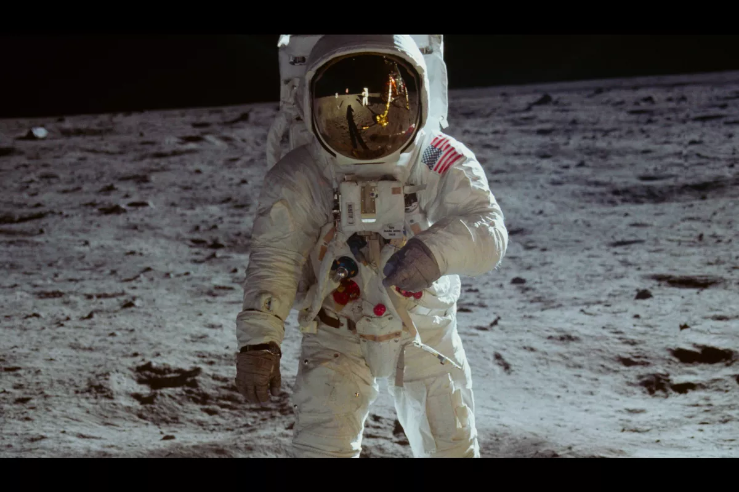
Starter:
Who is Neil Armstrong?
Why is Neil Armstrong a significant person?
What was Armstrong’s space mission called?
What date did he land on the moon?
Finish the quote: ‘That is one small _______ ____ ______ and one giant _________ ______ ______________.
Did you learn the meanings of any new words?
Notes:
Apollo 11
20th July 1969

Slide 2
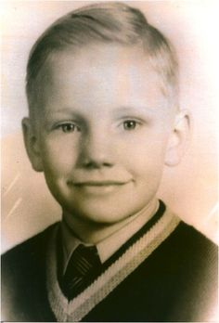
Neil Armstrong’s Life
Watch the video below:
History of Neil Armstrong for Kids - YouTube
Notes:
American video- we say aeroplane

Slide 3
Your Task: English and History
Create a timeline of Neil Armstrong’s Life.
What is a timeline? https://www.youtube.com/watch?v=xc64qurhFng
A timeline is a way of showing a list of events in the order they happened (called chronological order).
?

